Slide 1
Check-in
Review: Regular expressions
Write your name and answer the following on a piece of paper
Explain the difference between the languages recognized by these regular expressions:
  (cake)|(death)
  cake|death
Create a regular expression that is as short as possible (in terms of characters used to write down the regular expression) but matches the same language as:
a|(aa)|(a*)
The ? operator is sometimes used to denote "zero or one" repetitions of its operand. As as example a((bc)?) matches
  a (0 repetitions of bc)
  abc (1 repetition of bc).
Using the operators listed previously, change the above regular expression so that it doesn't use the ? operator but specifies the same language of strings. Hint: you may use the empty string symbol ε in your answer

Slide 2
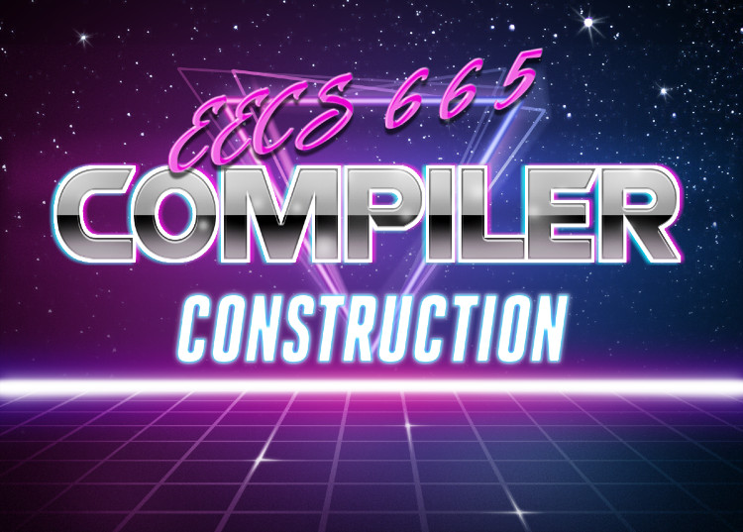
1 – Overview
KU | EECS | Drew Davidson

Slide 3
Introducing the GTAs
Administrivia & Announcements

Slide 4
Housekeeping
Administrivia & Announcements
Assignments
Entry Survey out now
  Due tonight at 11:59 PM
Written Work #1 out after class
  Due Wednesday at the beginning of class.
Lab 1 out tonight
  Due next Monday at 3:00 PM
Lab 2 out by Friday
  Due next next Monday at 3:00 PM
  Will be the subject of in-person labs next week

Slide 5
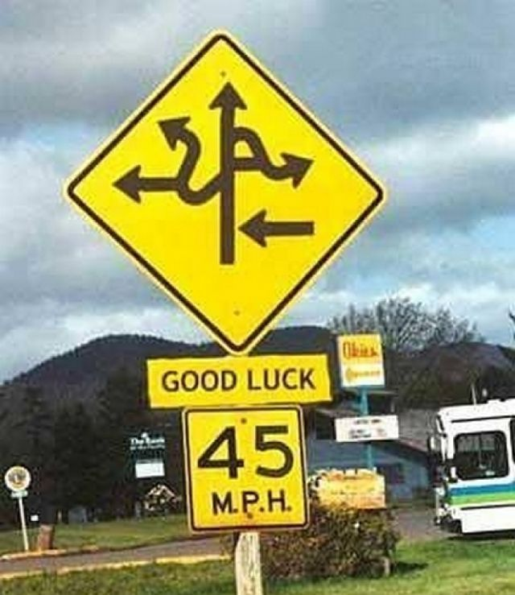
Today’s Roadmap
Lecture Outline
Orientation
  About me
  About you
  About the course
Overview the Compiler
Lexical Specification

Slide 6
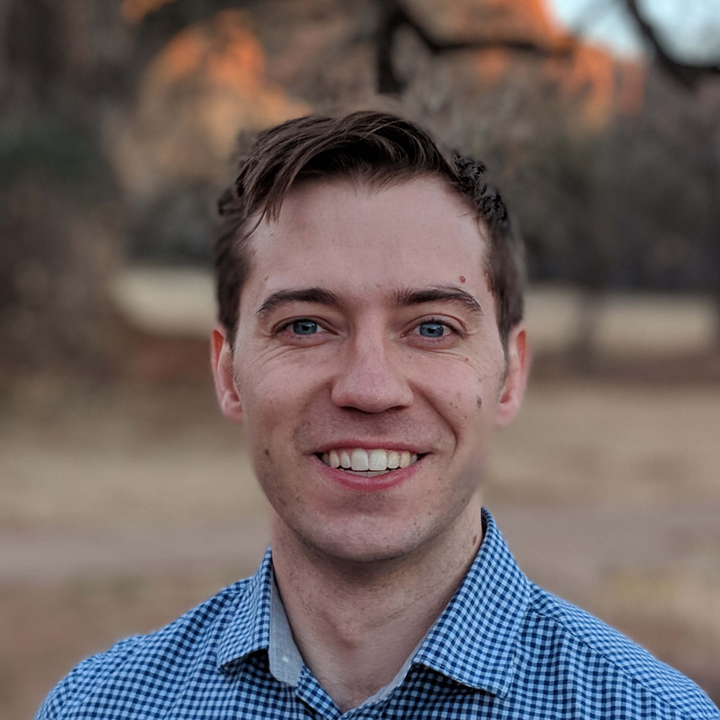
About Me
…and an
administrator
A scientist
…and also a
teacher
( Assistant ) Professor
Andrew “Drew” Davidson
Pronouns: he/him/his
Notes:
Try to be

Slide 7

What to call me
About Me
Preferred: “Drew”
Ok: “Professor Davidson”, “Dr. Davidson”
Never: “Andy”, “Andrew”, “Mr. Davidson”, “Dr. Drew”
Dr. Drew (Extremely not me) [1]
[1]: Credit: www.podcastone.com/Dr-Drew-Show

Slide 8
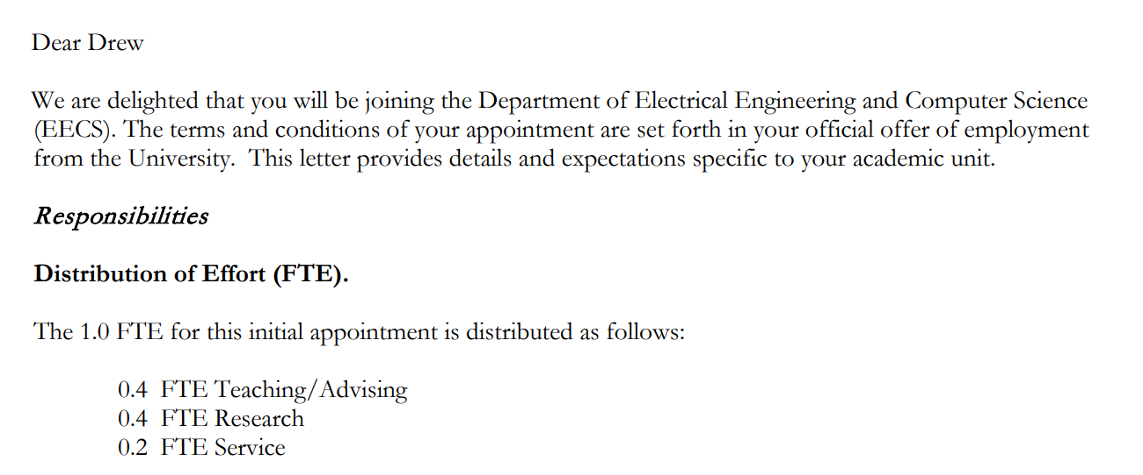
About Me: The Job of a Professor
About the class: FAQ
The actual start of my job offer letter from KU:

Slide 9

I’m a Busy Little Honeybee!
About Me
I love my job!
But there is a lot of it
I’d happily spend 40hrs/wk just on this class
Takeaways
Delays in email/grading can happen
I’m too busy to help?
Office hours are just for you
I try to scale my help
No! I’m here
for you!
This drives several
course policies

Slide 10

Interacting with Me
About Me
I am pretty friendly
I’ll make an effort to learn every student’s name
If you see me outside of class, feel free to say “hi!”
I like when you visit office hours
Appreciate when you come with a specific question
(I think)

Slide 11

About You
Notes:
Try to be

Slide 12

Your Time is Valuable!
Orientation - About You
There are a lot of assignments
Most of them are very quick
You don’t have to come to class
You are rewarded for doing so
Notes:
Try to be

Slide 13

One Small Favor
Orientation - About You
Help me to make this class pleasant
If you come to class, try to engage
  Frown when you are confused
  Grin when you are amused
  Ask questions if you have them
If you have feedback, let me know!
Notes:
Try to be

Slide 14


This course is built for y’all
Orientation - About You
I value feedback
  This course improves by matching your needs
  I encourage questions, comments, etc. (within reason)
I’ve taught this course before
  …but I’ve never taught YOU this course before
Notes:
Try to be

Slide 15

About The Class
Notes:
Try to be

Slide 16

What I think you NEED to Know
About the class
Read the syllabus: https://compilers.cool/syllabus.pdf
Notes:
Try to be

Slide 17

What I think you WANT to Know
About the class
Wondered
Notes:
Try to be

Slide 18
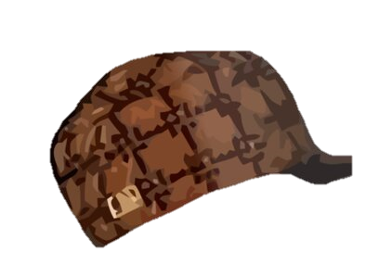

How ‘bout that Covid, eh?
About the class
Too Sick for Class?
You’re never required to come to class (except for tests)
If you’re too sick for a test, we’ll do a makeup
Too Sick to work?
Homework should take way less time than you’re given
Projects can collectively be turned in 6 days late for no penalties
Notes:
Try to be

Slide 19

Is This Class Hard?
About the class: FAQ
Definitely
this option

Slide 20
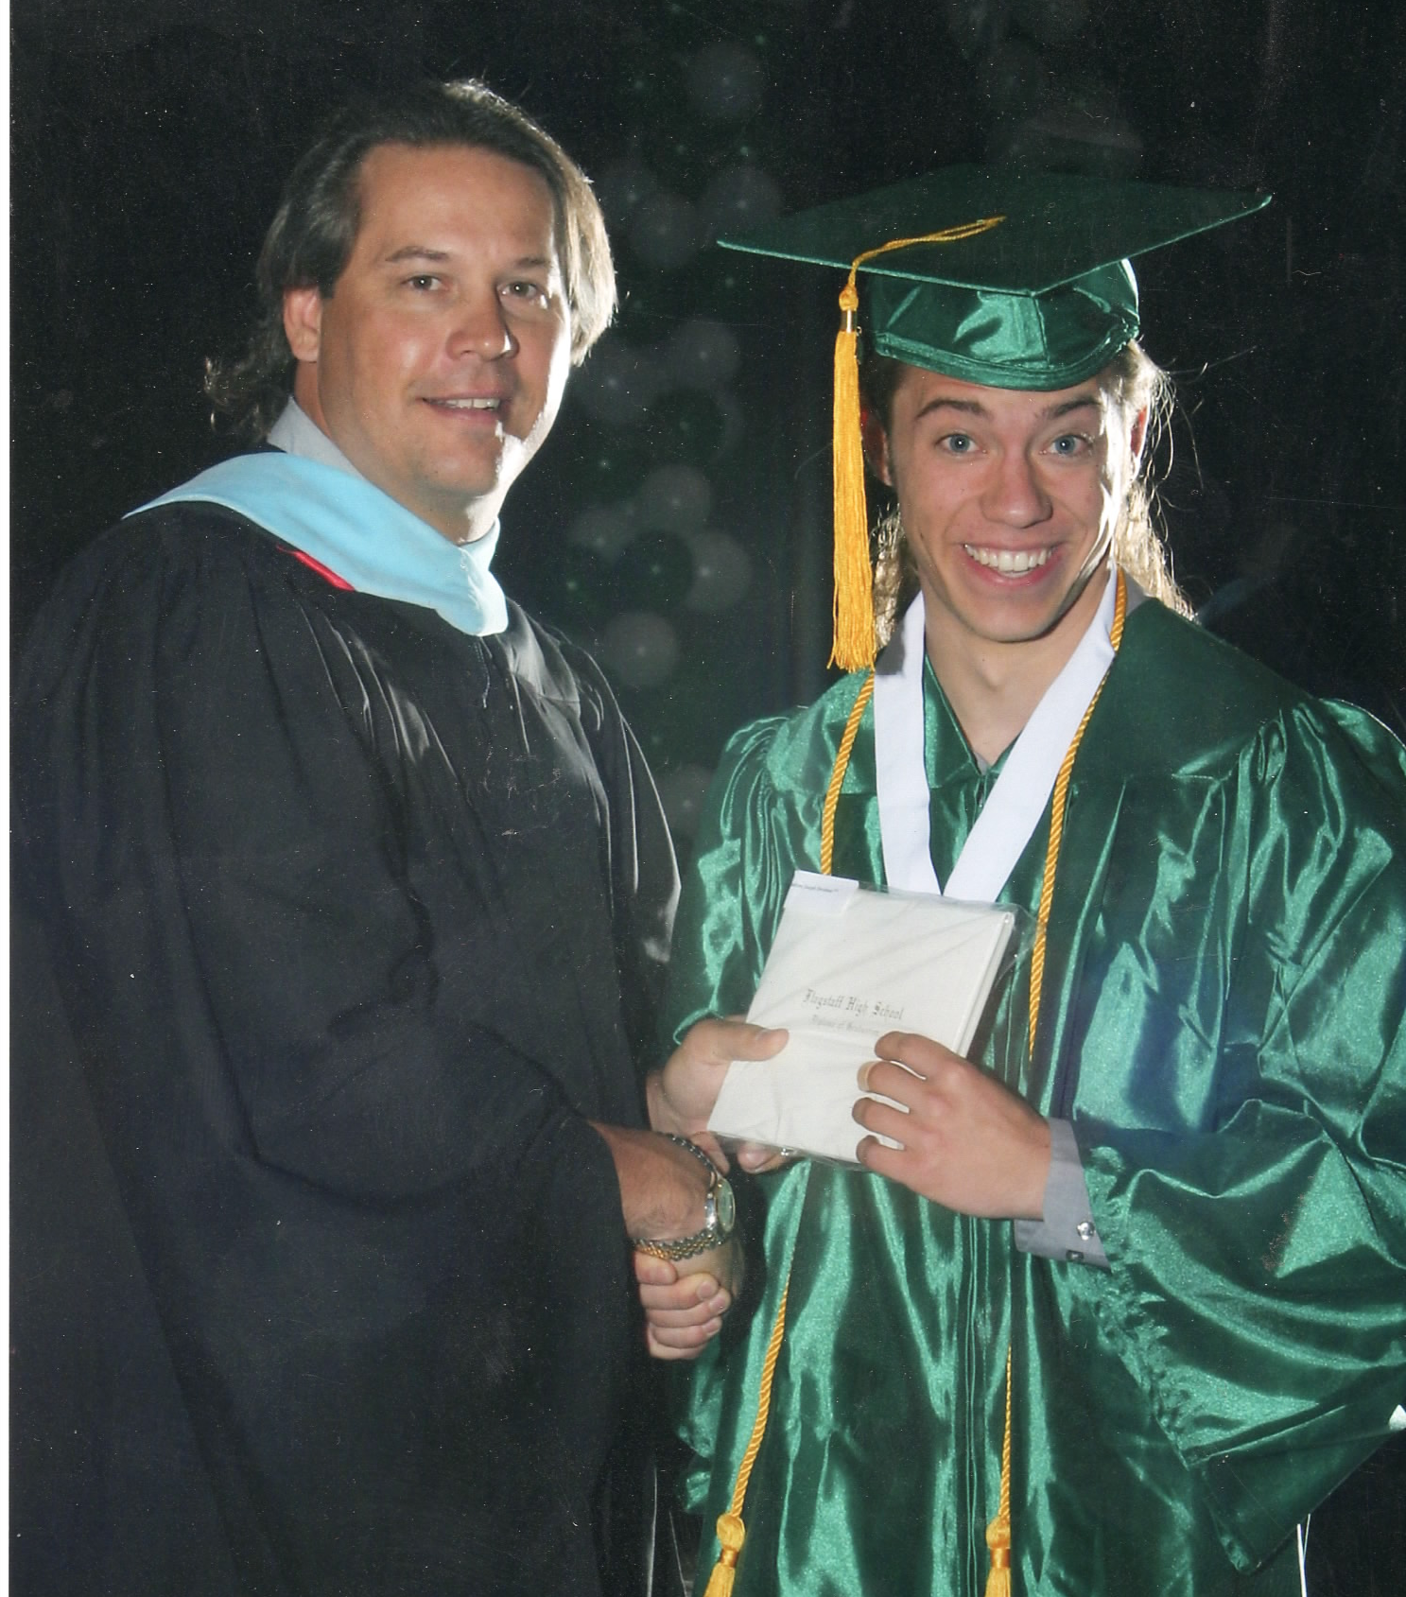
Is Drew a Good Teacher?
About the class: FAQ
My core philosophy: teach the class I’d want to take

Slide 21
Is Drew a Good Teacher?
About the class: FAQ
My couse design goal: teach the class I’d want to take
Put a lot of material in the course
Only post assignments after material is covered
Allow more time on assignments than needed
Make myself available
  Phone alerts for Piazza posts
  Respect office hours
Never require participation, always reward it
Provide lots of status/understanding checks
  The class is out of exactly 1000 points
  Frequent assignments, exercises in the class readings
  If you want to go above and beyond, extra assignments

Slide 22
Is This Class Hard?
About the class: FAQ
Definitely
this option
Let’s go with
“conceptually complex”
may depend on definition of “hard”
The class should be hard, because constructing compilers is hard

Slide 23
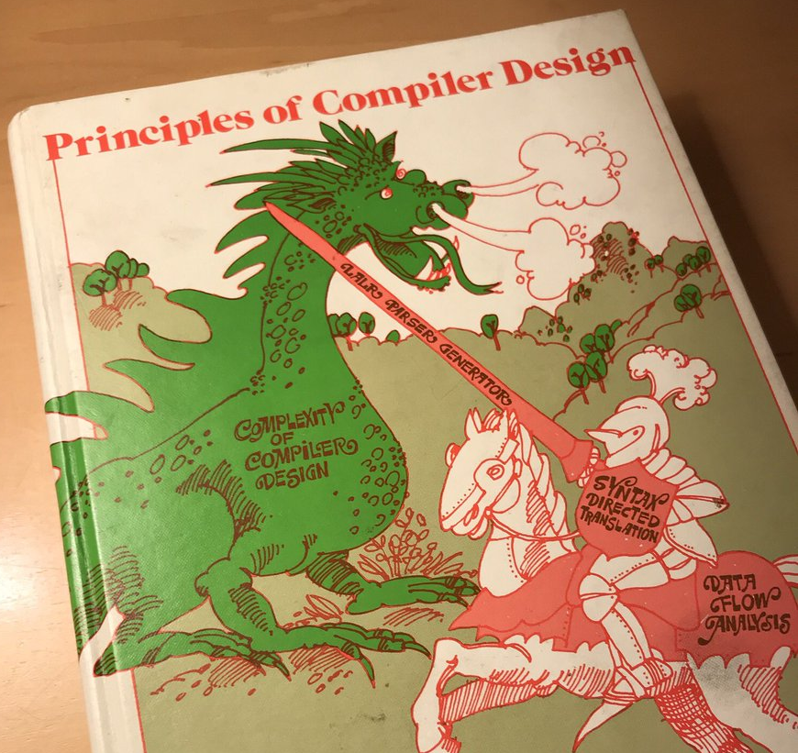
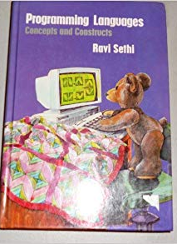
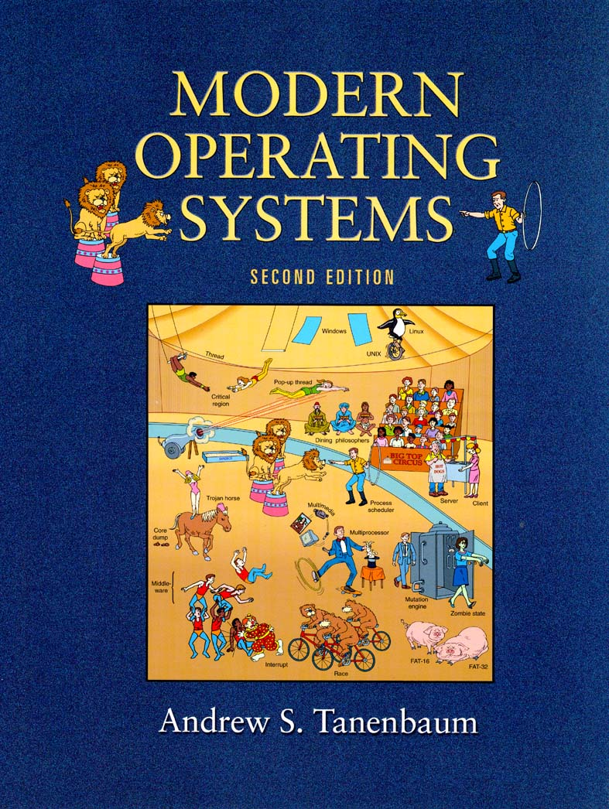
Let’s judge a book by it’s cover
About the class: A brief aside on complexity
Programming Languages
  Cute teddy bear!
Operating Systems
  Fun circus!
Compilers…
A dragon to murder
(and the dragon is pissed)

Slide 24
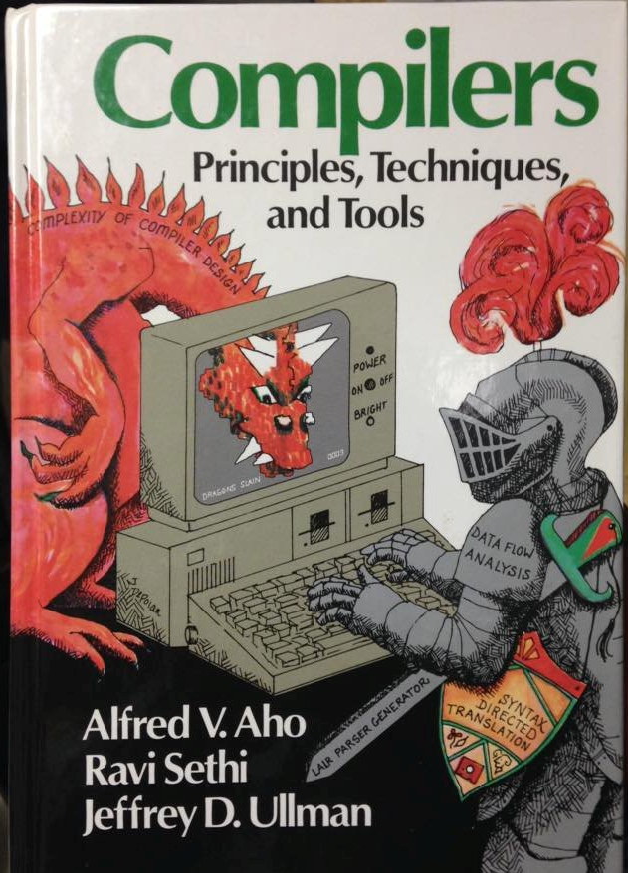
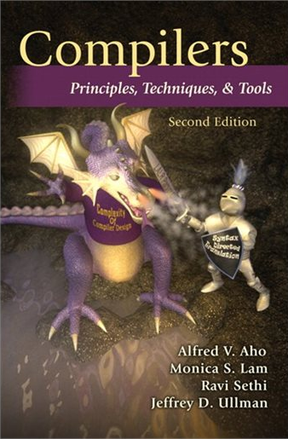

That’s just one book, right?
About the class: A brief aside on complexity
Uhh, actually dragons are like a whole thing
But why dragons?

Slide 25
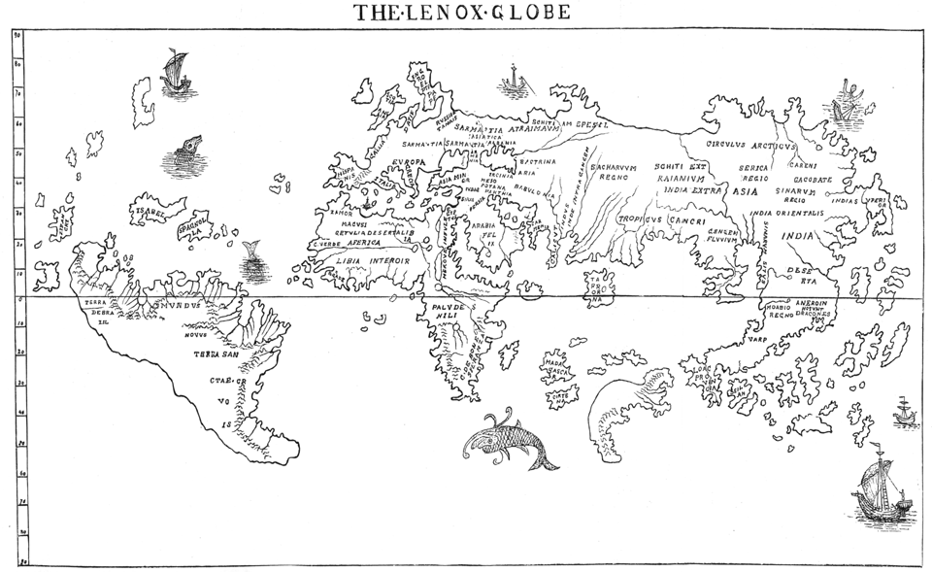
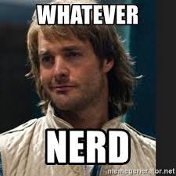
Dragons: symbols of the unknowable
About the class: A brief aside on complexity
“HC SVNT
DRACONES”
Roughly:
“Here be
dragons”

Slide 26

This Class is About Complexity of Design
About the class: A brief aside on complexity
We’ll wield the classic tools to combat complexity:
Formalisms
Abstractions
Modularity
Disciplined software design

Slide 27

Explore Design Complexity through Implementation
About the class
Let’s Build a Compiler!
Seems like a good thing to do in a class called “Compiler Construction”
Regardless of your interest in compilers, you’ll get to do some non-trivial code development

Slide 28
Today’s Lecture Roadmap
Lesson Outline
Orientation
  About you
  About me
  About the course
Overview the Compiler
Lexical Specification

Slide 29
What is a Compiler?
Overview the Compiler
(Audience participation)

Slide 30
What is a Compiler?
Overview the Compiler
Source code (sequence of chars)
S
Our working definition of a compiler
A recognizer of source language S and
a translator from source language S
to target language T written in host
language H
Our compiler
Host Language H = C++
Target language T = X64
Source language = ???
Compiler
???
Audience Participation:
What should we name our language?
H
For Us: C++
(or whatever you want)
T
For Us: X64
(very cool choice)
Output code in T

Slide 31
What is a Compiler?
Overview the Compiler
Source code (sequence of chars)
Compiler
Great! With our language defined, we can
resume exploring the compiler’s structure
Output code in T

Slide 32

What is a Compiler?
Overview the Compiler
Source code (sequence of chars)
Source code (sequence of chars)
Compiler
Frontend
Traditional compilers
Divided into phases
Frontend: input handling
Middleend: program reasoning
Backend: output handling
$$≈$$
Middleend
Backend
Output code in T
Output code in T

Slide 33
What is a Compiler?
Overview the Compiler
What do these modules do?
Source code (sequence of chars)
Frontend
Scanner
Lexical analysis
Parser
Syntactic analysis
Traditional compilers
Divided into phases
Frontend: input handling
Middleend: program reasoning
Backend: output handling
Middleend
Semantic analysis
Intermediate code generation
IR optimization
Phases further divided into modules
Backend
Final Code generation
Final code optimization
Output code in T

Slide 34
What is a Compiler?
Overview the Compiler
Scanner
Lexical analysis
Scanner: Transform input characters into tokens
(the “words” of the language)
Parser
Syntactic analysis
Parser: arrange tokens into syntax
(the “sentences” and “paragraphs” of the language)
Name analysis: bind identifiers
to their symbols
Semantic analysis
Semantic Analysis: Check properties of the
AST and add metadata
Type analysis: associate types
with operations
Intermediate code generation
Intermediate codegen: Transform AST into a more
“operational” internal representation
Intermediate Representation Optimization:
Structural improvements
IR optimization
Final Code generation
Final Code Generation: Translate IR into target
language representation
Final code optimization
Final Code Optimization: target-specific
optimizations

Slide 35
Compiler’s Recognizer Duties
Overview the Compiler
Lexical errors
Scanner
Lexical analysis
Scanner: Transform input characters into tokens
(the “words” of the language)
Parser: arrange tokens into syntax
(the “sentences” and “paragraphs” of the language)
Syntactic errors
Parser
Syntactic analysis
Naming errors
Name analysis: bind identifiers
to their symbols
Semantic analysis
Semantic Analysis: Check properties of the
AST and add metadata
Type analysis: associate types
with operations
Intermediate code generation
Intermediate codegen: Transform AST into a more
“operational” internal representation
Type errors
Intermediate Representation Optimization:
Structural improvements
IR optimization
Final Code generation
Final Code Generation: Translate IR into target
language representation
Final code optimization
Final Code Optimization: target-specific
optimizations

Slide 36
Our Class Workflow
Overview the Compiler
Scanner
Lexical analysis
P1
We’ll work through the compiler front-to-back
Pause on background information as needed
Review underlying theory, implementation details, and techniques as needed
P2
Parser
Syntactic analysis
P3
Semantic analysis
P4
P5
Intermediate code generation
P6
Often need to…
Precisely define / express some language concept
Build a recognizer of that concept
Build a translator for that concept
IR optimization
Final Code generation
P7
P8
Final code optimization

Slide 37
Exploring Lexical Analysis Design
Lexicial Analysis
Scanner
Lexical analysis
P1
We’ll work through the compiler front-to-back
Pause on background information as needed
Review underlying theory, implementation details, and techniques as needed
P2
Parser
Syntactic analysis
P3
Semantic analysis
P4
P5
Intermediate code generation
P6
Often need to…
Precisely define / express some language concept
Build a recognizer of that concept
Build a translator for that concept
IR optimization
Final Code generation
P7
P8
Final code optimization

Slide 38
Exploring Lexical Analysis Design
Overview the Compiler
Often need to…
Precisely define / express some language concept
Build a recognizer of that concept
Build a translator for that concept
Scanner
Lexical analysis
We’ll use some (hopefully) familiar theory
techniques in building the scanner:
Regular Languages / Regular Expressions
Deterministic Finite Automata
Nondeterministic Finite Automata
These would be good concepts to
review if you’re shaky on them

Slide 39

Lexical Definition
Overview the Compiler
Describe the tokens (i.e. the “words”) of the language using regular expressions
Token
Examples
Integer Literal
1
230
0|(1|2|3|4|5|6|7|8|9)(0|1|2|3|4|5|6|7|8|9)*
star
*
“*”

Slide 40

Key RegEx Features
RegEx Properties
  Closed under…
    Concatenation
    Union
    Repetition
    Complementation
    …and more!
  Equivalent to DFAs
By Construction!

Slide 41
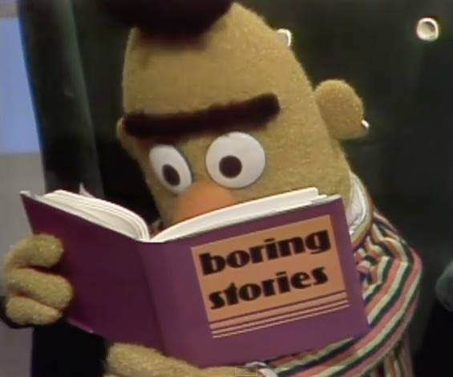

RegEx $≡$ DFA… So What?
RegEx Properties
This matters for implementation!

Slide 42
DFAs: Easy to Implement
RegEx Properties
DFA (Graph Depiction)
S
x
A
x,y
D
D
DFA (Successor Notation)
DFA (Array Implementation)
<Current state>,<Transition symbol> = <next state>
Row: current state
Column: transition symbol
Cell: next state
S,x = A
A,x = D
A,y = D
 | x | y
S | A
A | D | D
D

Slide 43
RegEx $≡$ DFA… So What?
RegEx Properties
(From 3 slides ago)
Often need to…
Precisely define / express language concept
Build a recognizer of that concept
Build a translator for that concept
Define tokens as regular expressions
Automatically convert regExes to DFAs
Run recognizer as DFA tables

Slide 44
Lecture Wrap-Up
Goodbye for now!
Summary
Working definition of a compiler
Compiler overview
  Phases of the compiler
  Modules of the phases
Next Lecture
Describe how we can build a token recognizer from the specification
Your ToDos:
Survey due at midnight tonight
If you missed class, C1 is due Sunday at midnight
Familiarize yourself with https://compilers.cool
Sign up for Piazza
If you need some theory review, check out https://compilers.cool/theory_review/

