Slide 1
Check-In
Review: Compiler Overview
The “traditional” compiler workflow presented in class creates an intermediate format in the middle-end. Why not translate directly from the AST (abstract syntax tree) to final code?

Slide 2
Administriva
Housekeeping
Project 1
Out tonight
Add Flex rules for our language
Might want to find a project partner!

Slide 3
Administriva
Housekeeping
What should we call our language?

Slide 4
Surveys (Mostly) Processed
Housekeeping
We will do flipped Wednesdays
I’ll try to put out some 510 review

Slide 5

2 – Implementing Scanners
KU | EECS 665 | Drew Davidson

Slide 6


Compiler Construction
Progress Pics
Currently working on lexical analysis concepts
Convert the character stream from the user into the token stream (the “words” of the programming language)
Scanner
Lexical analysis
Parser
Syntactic analysis
Semantic analysis
Intermediate code generation
IR optimization
Final Code generation
Final code optimization

Slide 7
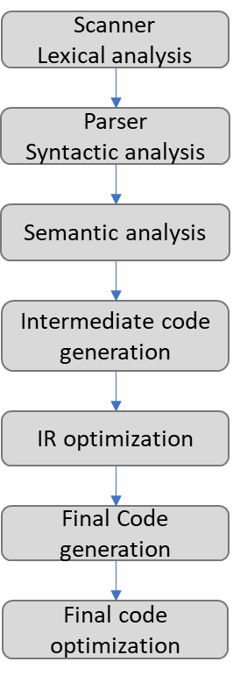
Last Time
Review: Overview
Introduced a definition of a compiler and its workflow
Used RegExs to specify languages of tokens
Claimed RegExs can be automatically translated to recognize languages
RegEx
“+”
Token
Integer Literal
RegEx
0|(1|2|…|9)(0|1|…|9)*
DFA
+
S
A
E
In lab we showed a tool that
automatically does this
translation (Flex)
You Should Know
The phases of the compiler and what each step does
What errors the various phases catch
How to specify a token’s lexemes with a regex

Slide 8
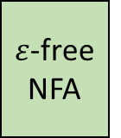
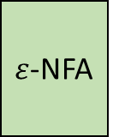

Lecture Overview
Lecture 2 – Implementing Scanners
Walk through the translation process formally
RegEx
$ε$-NFA
$ε$-free NFA
DFA
Thompson’s
Construction
Algorithm
$ε$-elimination
Rabin-Scott
Powerset
Construction

Slide 9


Key Concept
Thompson’s Construction Algorithm
Use an expression tree:
  Leaf: atomic operand
  Branch: operations joining subtrees
Expression Tree Examples
Arithmetic Expression
RegEx
1 $+2$ $×$ 3 $+$ 4
a|b*
Arithmetic Expression Tree
Expression Tree
+
low precedence
operators shallow
in the tree
|
1
+
a
*
$$×$$
4
NOTE:
high precedence
operators deep
in the tree
b
2
3

Slide 10

Thompson’s Construction Intuition
Thompson’s Construction Algorithm
Two-Step Process:
Break the RegEx down to the simplest units with “obvious” FSMs (i.e. expression tree leaves)
Combine the sub-FSMs according to operator rules (i.e. expression tree branch rules)
Recombobulate the Regex into an FSM piecewise

Slide 11


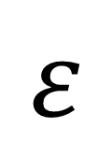
Thompson’s Construction Alg.
Build the RegEx Tree | Replace nodes bottom-up
Op | Precedence
* | High
concat | Medium
| | Low
(a|$ε$)(c|d|b)*
concat
|
*
(c|d|b)*
a | $ε$
a
$$ε$$
|
c|d|b
c
d|b
|
Apply rules bottom up:
- convert leaf nodes (RegEx operands) to DFAs
- combine branch nodes (RegEx operators) per operator
b
d

Slide 12

Thompson’s Construction Alg.
Build the RegEx Tree | Replace nodes bottom-up
Op | Precedence
* | High
concat | Medium
| | Low
(a|$ε$)(c|d|b)*
concat
|
*
(c|d|b)*
a | $ε$
a
$$ε$$
|
c|d|b
a
$$ε$$
S_{A}
A
S_{E}
A
A
E
c
d|b
|
c
S_{C}
A
C
Apply rules bottom up:
- convert leaf nodes (RegEx operands) to DFAs
- combine branch nodes (RegEx operators) per operator
b
d
d
b
S_{D}
A
S_{B}
A
D
B

Slide 13




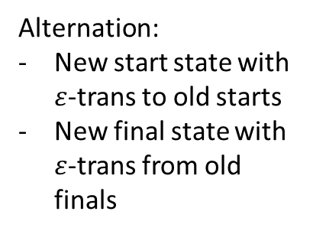

Thompson’s Construction Alg.
Build the RegEx Tree | Replace nodes bottom-up
Alternation:
New start state with $ε$-trans to old starts
New final state with $ε$-trans from old finals
(a|$ε$)(c|d|b)*
concat
|
*
(c|d|b)*
a | $ε$
|
c|d|b
a
$$ε$$
S_{A}
A
S_{E}
A
A
E
d|b
|
a
c
S_{A}
A
S_{C}
A
$$ε$$
$$ε$$
C
S
L
$$ε$$
$$ε$$
d
S_{E}
E
$$ε$$
b
S_{D}
A
S_{B}
A
D
B

Slide 14





Thompson’s Construction Alg.
Build the RegEx Tree | Replace nodes bottom-up
Alternation:
New start state with $ε$-trans to old starts
New final state with $ε$-trans from old finals
(a|$ε$)(c|d|b)*
concat
a
*
(c|d|b)*
a | $ε$
S_{A}
A
$$ε$$
$$ε$$
S
L
$$ε$$
$$ε$$
|
c|d|b
S_{E}
E
$$ε$$
d|b
|
c
S_{C}
A
C
d
b
S_{D}
A
S_{B}
A
D
B

Slide 15




Thompson’s Construction Alg.
Build the RegEx Tree | Replace nodes bottom-up
Alternation:
New start state with $ε$-trans to old starts
New final state with $ε$-trans from old finals
(a|$ε$)(c|d|b)*
concat
a
*
(c|d|b)*
a | $ε$
S_{A}
A
$$ε$$
$$ε$$
S
L
$$ε$$
$$ε$$
|
c|d|b
S_{E}
E
$$ε$$
d|b
c
S_{C}
A
d
C
S_{D}
D
$$ε$$
$$ε$$
S
A
M
$$ε$$
b
S_{B}
B
$$ε$$

Slide 16







Thompson’s Construction Alg.
Build the RegEx Tree | Replace nodes bottom-up
Alternation:
New start state with $ε$-trans to old starts
New final state with $ε$-trans from old finals
(a|$ε$)(c|d|b)*
concat
a
*
(c|d|b)*
a | $ε$
S_{A}
A
$$ε$$
$$ε$$
S
L
$$ε$$
$$ε$$
|
c|d|b
S_{E}
E
$$ε$$
c
S_{C}
C
$$ε$$
d|b
$$ε$$
c
d
A
S_{C}
A
d
N
C
D
S
S_{A}
A
$$ε$$
S_{D}
$$ε$$
$$ε$$
$$ε$$
$$ε$$
S_{M}
M
S
A
M
$$ε$$
b
$$ε$$
b
S_{E}
E
$$ε$$
S_{B}
B
$$ε$$

Slide 17







Thompson’s Construction Alg.
Build the RegEx Tree | Replace nodes bottom-up
Alternation:
New start state with $ε$-trans to old starts
New final state with $ε$-trans from old finals
(a|$ε$)(c|d|b)*
concat
a
*
(c|d|b)*
a | $ε$
S_{A}
A
$$ε$$
$$ε$$
S
L
$$ε$$
$$ε$$
S_{E}
E
$$ε$$
c
S_{C}
C
$$ε$$
$$ε$$
d
A
N
S
S_{A}
A
$$ε$$
$$ε$$
$$ε$$
S_{M}
M
$$ε$$
b
S_{E}
E
$$ε$$

Slide 18
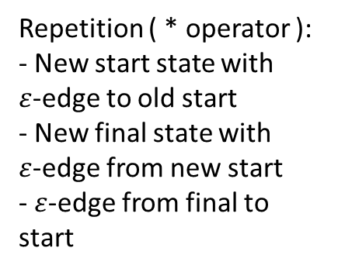
Thompson’s Construction Alg.
Build the RegEx Tree | Replace nodes bottom-up
Repetition ( * operator ):
- New start state with $ε$-edge to old start
- New final state with $ε$-edge from new start
- $ε$-edge from final to start
(a|$ε$)(c|d|b)*
concat
a
*
(c|d|b)*
a | $ε$
S_{A}
A
$$ε$$
$$ε$$
S
L
$$ε$$
$$ε$$
S_{E}
E
$$ε$$
c
S_{C}
C
$$ε$$
$$ε$$
d
A
N
S
S_{A}
A
$$ε$$
$$ε$$
$$ε$$
S_{M}
M
$$ε$$
b
S_{E}
E
$$ε$$

Slide 19























Thompson’s Construction Alg.
Build the RegEx Tree | Replace nodes bottom-up
Repetition ( * operator ):
- New start state with $ε$-edge to old start
- New final state with $ε$-edge from new start
- $ε$-edge from final to start
(a|$ε$)(c|d|b)*
concat
(c|d|b)*
a | $ε$
S_{A}
a
A
*
$$ε$$
$$ε$$
S
A
L
$$ε$$
$$ε$$
c|d|b
S_{E}
E
$$ε$$
$$ε$$
c
$$ε$$
S_{C}
C
A
N
c
$$ε$$
$$ε$$
S_{C}
C
N
d
S
S_{D}
D
$$ε$$
d
$$ε$$
$$ε$$
S
$$ε$$
S_{N}
S_{A}
A
$$ε$$
S_{M}
M
$$ε$$
$$ε$$
A
O
$$ε$$
b
S_{M}
M
S_{B}
B
$$ε$$
$$ε$$
b
S_{E}
E
$$ε$$
$$ε$$

Slide 20









Thompson’s Construction Alg.
Build the RegEx Tree | Replace nodes bottom-up
Repetition ( * operator ):
- New start state with $ε$-edge to old start
- New final state with $ε$-edge from new start
- $ε$-edge from final to start
(a|$ε$)(c|d|b)*
concat
(c|d|b)*
a | $ε$
a
A
c
$$ε$$
S_{A}
$$ε$$
$$ε$$
S_{C}
C
N
$$ε$$
S
A
d
$$ε$$
L
$$ε$$
S_{D}
D
$$ε$$
S
S_{C}
$$ε$$
$$ε$$
$$ε$$
A
S_{E}
E
$$ε$$
O
S_{M}
M
$$ε$$
b
S_{B}
B
$$ε$$
$$ε$$

Slide 21



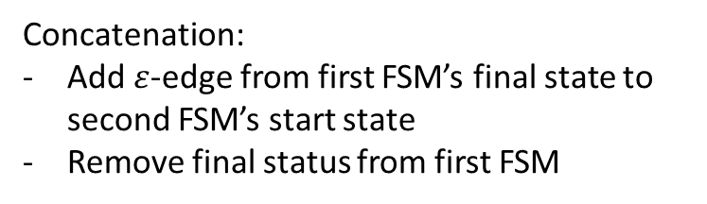
Thompson’s Construction Alg.
Build the RegEx Tree | Replace nodes bottom-up
Concatenation:
Add $ε$-edge from first FSM’s final state to second FSM’s start state
Remove final status from first FSM
(a|$ε$)(c|d|b)*
concat
(c|d|b)*
a | $ε$
a
A
c
$$ε$$
S_{A}
$$ε$$
$$ε$$
S_{C}
C
N
$$ε$$
S
A
d
$$ε$$
L
$$ε$$
S_{D}
D
$$ε$$
S
S_{C}
$$ε$$
$$ε$$
$$ε$$
A
S_{E}
E
$$ε$$
O
S_{M}
M
$$ε$$
b
S_{B}
B
$$ε$$
$$ε$$

Slide 22

Thompson’s Construction Alg.
Build the RegEx Tree | Replace nodes bottom-up
Concatenation:
Add $ε$-edge from first FSM’s final state to second FSM’s start state
Remove final status from first FSM
(a|$ε$)(c|d|b)*
concat
(c|d|b)*
a | $ε$
a
A
c
$$ε$$
S_{A}
$$ε$$
$$ε$$
S_{C}
C
N
$$ε$$
$$ε$$
S
L
d
$$ε$$
S_{O}
$$ε$$
S_{C}
S_{D}
D
$$ε$$
$$ε$$
$$ε$$
A
$$ε$$
S_{E}
E
$$ε$$
O
S_{M}
M
$$ε$$
b
S_{B}
B
$$ε$$
$$ε$$

Slide 23







Thompson’s Construction Alg.
Build the RegEx Tree | Replace nodes bottom-up
(a|$ε$)(c|d|b)*
c
$$ε$$
a
$$ε$$
S_{C}
C
N
S_{A}
A
$$ε$$
$$ε$$
$$ε$$
d
$$ε$$
S
L
S_{O}
$$ε$$
S_{C}
S_{D}
D
$$ε$$
$$ε$$
A
$$ε$$
O
$$ε$$
S_{E}
E
$$ε$$
S_{M}
M
$$ε$$
b
S_{B}
B
$$ε$$
$$ε$$

Slide 24

Thompson’s Construction: Side-Note
Build the RegEx Tree | Replace nodes bottom-up
The FSMs produced by Thompsons Construction are a little bit messy!
Clearly less efficient than what we would do by hand
Designed for ease of proofs
In practice, it’s easy to minimize FSMs later

Slide 25


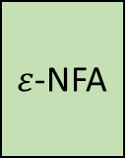

From RegEx to DFA
Lecture 2 – Implementing Scanners
RegEx
$ε$-NFA
$ε$-free NFA
DFA
Thompson’s
Construction
Algorithm
$ε$-elimination
Rabin-Scott
Powerset
Construction

Slide 26





Eliminating $ε$-transitions
Lecture 2 – Implementing Scanners
Observation: You never see an epsilon in the input
  Consuming a character means taking a “chain” of zero-or-more 𝜀-edges then a real character edge
Algorithm Intuition: cut out the middleman
  Replace all “chains” with a direct real-character edge
Input: a
S
S
$$ε$$
$$ε$$
1
2
a
$$ε$$
$$ε$$
2
3
b
a
b
a
a
S
S
3
4

Slide 27

Eliminating $ε$-transitions
Lecture 2 – Implementing Scanners
Compute $ε$-close(s), the set of states reachable via 0 or more $ε$-edges from s
Copy all states from N to an $ε$-free version, N’
Put s in F’ if $ε$-close(s) contains a state in F
Put s,c $→$ t in $δ$’ if there is a c-edge to t in $ε$-close(s)

Slide 28
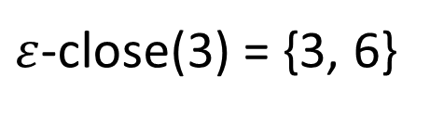
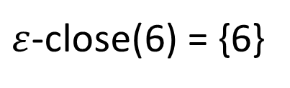

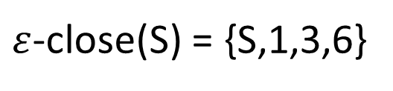
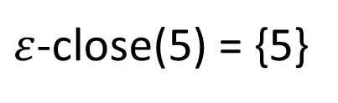

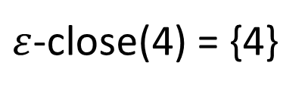

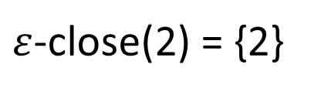

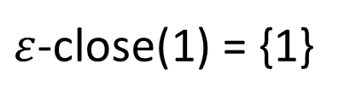
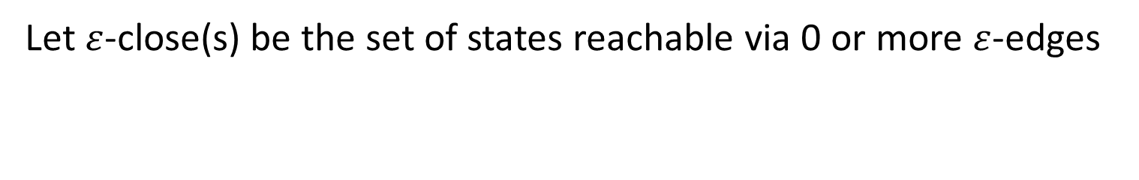
Example, Step I
Eliminating $ε$-Transitions
Let $ε$-close(s) be the set of states reachable via 0 or more $ε$-edges
6
$ε$-close(S) = {S,1,3,6}
$ε$-close(3) = {3, 6}
S
$$ε$$
$$ε$$
$ε$-close(1) = {1}
C
3
$ε$-close(2) = {2}
$$ε$$
x
$ε$-close(4) = {4}
1
4
x
$ε$-close(5) = {5}
x
x
$ε$-close(6) = {6}
2
x
5

Slide 29

Example, Step II
Eliminating $ε$-Transitions
  Copy all states from N to N’
6
6
$ε$-close(S) = {S,1,3,6}
$ε$-close(3) = {3, 6}
S
S
$$ε$$
$$ε$$
$ε$-close(1) = {1}
C
3
C
3
$ε$-close(2) = {2}
$$ε$$
x
$ε$-close(4) = {4}
1
4
1
4
x
$ε$-close(5) = {5}
x
x
5
$ε$-close(6) = {6}
2
2
x
5

Slide 30


Example, Step III
Eliminating $ε$-Transitions
  Put s in F’ if $ε$-close(s) contains a state in F
6
6
$ε$-close(S) = {S,1,3,6}
$ε$-close(3) = {3, 6}
S
S
S
$$ε$$
$$ε$$
$ε$-close(1) = {1}
C
3
C
3
$ε$-close(2) = {2}
$$ε$$
x
$ε$-close(4) = {4}
1
4
1
4
x
$ε$-close(5) = {5}
x
x
5
$ε$-close(6) = {6}
2
2
x
5

Slide 31


Example, Step IV
Eliminating $ε$-Transitions
  Put s,c $→$ t in $δ$’ if there is a c-edge to t in $ε$-close(s)
6
6
$ε$-close(S) = {S,1,3,6}
$ε$-close(3) = {3, 6}
S
S
S
$$ε$$
$$ε$$
$ε$-close(1) = {1}
C
3
C
3
$ε$-close(2) = {2}
$$ε$$
$$ε$$
x
$ε$-close(4) = {4}
x
1
4
1
4
x
$ε$-close(5) = {5}
x
x
x
5
$ε$-close(6) = {6}
2
2
x
5

Slide 32

Example, Step IV
Eliminating $ε$-Transitions
  Put s,c $→$ t in $δ$’ if there is a c-edge to t in $ε$-close(s)
6
6
$ε$-close(S) = {S,1,3,6}
$ε$-close(3) = {3, 6}
S
S
S
$$ε$$
$$ε$$
$$ε$$
C
$ε$-close(1) = {1}
3
C
x
3
$ε$-close(2) = {2}
$$ε$$
x
x
$ε$-close(4) = {4}
x
1
4
1
4
x
$ε$-close(5) = {5}
x
x
5
$ε$-close(6) = {6}
2
2
x
5

Slide 33
Example, Step IV
Eliminating $ε$-Transitions
  Put s,c $→$ t in $δ$’ if there is a c-edge to t in $ε$-close(s)
6
6
No edges out of 6!
$ε$-close(S) = {S,1,3,6}
$ε$-close(3) = {3, 6}
S
S
S
$$ε$$
$$ε$$
$ε$-close(1) = {1}
C
3
C
x
3
$ε$-close(2) = {2}
$$ε$$
x
$ε$-close(4) = {4}
x
1
4
1
4
x
$ε$-close(5) = {5}
x
x
5
$ε$-close(6) = {6}
2
2
x
5

Slide 34
Example, Step IV
Eliminating $ε$-Transitions
  Put s,c $→$ t in $δ$’ if there is a c-edge to t in $ε$-close(s)
Note: this definition necessarily preserves all original non-$ε$ edges
6
6
$ε$-close(S) = {S,1,3,6}
$ε$-close(3) = {3, 6}
S
S
S
$$ε$$
$$ε$$
$ε$-close(1) = {1}
C
3
C
x
3
$ε$-close(2) = {2}
$$ε$$
x
x
$ε$-close(4) = {4}
x
1
4
1
4
x
x
$ε$-close(5) = {5}
x
x
x
x
x
5
$ε$-close(6) = {6}
2
2
x
5

Slide 35

Example, Done!
Eliminating $ε$-Transitions
Can also remove unreachable “useless” state
6
6
=
S
S
S
$$ε$$
$$ε$$
C
3
C
x
3
$$ε$$
x
x
x
1
4
1
4
x
x
x
x
x
x
x
5
2
2
x
5

Slide 36




Example, Step IV
Eliminating $ε$-Transitions
  Put s,c $→$ t in $δ$’ if there is a c-edge to t in $ε$-close(s)
6
$ε$-close(S) = {S,1,3,6}
6
S
S
$$ε$$
$$ε$$
S
C
C
x
3
3
$$ε$$
x
x
1
4
x
1
4
x
x
x
x
x
x
x
5
2
x
5
2

Slide 37
From RegEx to DFA
Lecture 2 – Implementing Scanners
RegEx
$ε$-NFA
$ε$-free NFA
DFA
Thompson’s
Construction
Algorithm
$ε$-elimination
Rabin-Scott
Powerset
Construction

Slide 38
Recall: NFA Matching Procedure
Rabin-Scott Powerset construction
Successor
set of
states
NFA can “choose” which transition to take
  Always moves to states that leads to acceptance (if possible)
Simulate set of states the NFA could be in
  If any state in the ending set is final, string accepted
S,x = {S,A}
R,x = {D}
S,y = {S}
R,y = {D}
A,x = {R}
D,x = {}
A,y = {R}
D,y = {}
NFA
S
x
A
x,y
R
x,y
D
D
x,y
Input String
x
x
y
x
position
0
1
2
3
4
possible
states
S
S
S
S
S
A
A
A
R
D
R
D

Slide 39
From Successors to Powerset DFA
Rabin-Scott Powerset Construction
S,x = {S,A}
A,x = {R}
R,x = {D}
D,x = {}
S,y = {S}
A,y = {R}
R,y = {D}
D,y = {}
y
{S}
x
{S,A}
{S,A, R}
D
{S,D}
{S,A,R,D}
{A,R,D}
{S,D}
{S,R}
{S,A,D}
D
{A,R}
{S,D}
{S,A,D}
{S,R,D}
{S,D}
{A}
x,y
{R}
x,y
{S,D}
{A,D}
{D}
{R,D}

Slide 40
From Successors to Powerset DFA
Rabin-Scott Powerset Construction
S,x = {S,A}
A,x = {R}
R,x = {D}
D,x = {}
S,y = {S}
A,y = {R}
R,y = {D}
D,y = {}
{S,A}, x
= S,x U A,x
= {S,A} U {R}
y
= {S,A,R}
{S}
x
{S,A}
x
{S,A, R}
D
{S,D}
{S,A,R,D}
{A,R,D}
{S,D}
{S,R}
{S,A,D}
D
{A,R}
{S,D}
{S,A,D}
{S,R,D}
{S,D}
{A}
x,y
{R}
x,y
{S,D}
{A,D}
{D}
{R,D}

Slide 41
From Successors to Powerset DFA
Rabin-Scott Powerset Construction
S,x = {S,A}
A,x = {R}
R,x = {D}
D,x = {}
S,y = {S}
A,y = {R}
R,y = {D}
D,y = {}
{S,A}, y
= S,y U A,y
= {S} U {R}
y
= {S,R}
{S}
x
{S,A}
x
{S,A, R}
x
D
{S,D}
{S,A,R,D}
{A,R,D}
y
{S,D}
{S,R}
{S,A,D}
D
{A,R}
{S,D}
{S,A,D}
{S,R,D}
{S,D}
{A}
x,y
{R}
x,y
{S,D}
{A,D}
{D}
{R,D}

Slide 42
From Successors to Powerset DFA
Rabin-Scott Powerset Construction
S,x = {S,A}
A,x = {R}
R,x = {D}
D,x = {}
S,y = {S}
A,y = {R}
R,y = {D}
D,y = {}
y
x
{S}
x
{S,A}
x
{S,A, R}
x
D
{S,D}
{S,A,R,D}
{A,R,D}
x
y
y
y
x
x
{S,D}
{S,R}
{S,A,D}
x
D
{A,R}
{S,D}
{S,A,D}
{S,R,D}
y
y
{S,D}
{A}
x,y
{R}
x,y
{S,D}
{A,D}
{D}
{R,D}

Slide 43
Exponential State Count
Rabin-Scott Powerset Construction
How may states might the DFA have?
  2^{|Q|}
Why 2^{|Q|}?
S
A
D
S
x
A
x,y
D
0
0
0
{}
D
0
0
1
{D}
0
1
0
{A}
1
0
0
{S}
x,y
0
1
1
{A,D}
1
1
0
{S,A}
1
0
1
{S,D}
1
1
1
{S,A,D}

Slide 44
From RegEx to DFA
Lecture 2 – Implementing Scanners
RegEx
$ε$-NFA
$ε$-free NFA
DFA
Thompson’s
Construction
Algorithm
$ε$-elimination
Rabin-Scott
Powerset
Construction
DONE!
… or are we?

Slide 45
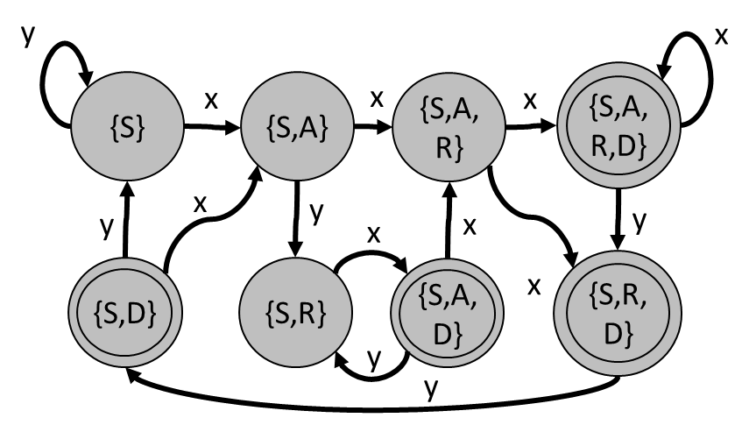




DFA $≠$ Tokenizer
Limitations
Finite automata only check for language membership of a string (recognition)
The Scanner needs to
  Break the input into many different tokens
  Know what characters comprise the token
input string
int a; b = 3 + 2;
DFA
recognition
or

Slide 46

DFA $≠$ Tokenizer
Limitations
Finite automata only check for language membership of a string (recognition)
The Scanner needs to
  Break the input into many different tokens
  Know what characters comprise the token
We need to go… beyond recognition
input string
int a; b = 3 + 2;
DFA
recognition
or

Slide 47
Next Time
Lecture 3 Preview
Source code in S (sequence of chars)
Lexical Definition
Lexical Recognition
Tokenization
Scanner
Lexical analysis
Next
Time
Syntactic Definition
Syntactic Recognition
Parsing
Parser
Syntactic analysis
Next
Time
(Soon)
(Soon)
Semantic analysis
Intermediate code generation
IR optimization
Final Code generation
Final code optimization
Output code in T

