Slide 1
Check-In
Review: Syntactic Ambiguity
Consider the following grammar for addition and multiplication:
E ⟶ E plus E
E ⟶
T ⟶ T times T
T ⟶ F
F ⟶ intlit
Add parentheses to the above grammar. The new rule(s) should maintain implicit precendence, but allow parens that can override it. Don't worry about making the grammar unambiguous. Does this change whether the grammar is left-recursive, right-recursive, or recursive?

Slide 2
Administrivia
Housekeeping
Live Assignments
P1
H2
Project 1 is due tonight!
If you need more time:
  Turn in tomorrow for -15% (or 1 late token)
  Turn in Saturday for -30% (or 2 late tokens, or -15% & 1 token)

Slide 3

Lecture 5
Syntax-Directed Definition
University of Kansas | Drew Davidson

Slide 4

COMPILER
Code Generation
Execution
Runtime Environment
Intermediate
Representation
Optimization
SDD
Parsing
Semantics
Lexical Analysis
Syntactic
Definiton

Slide 5

Lecture Outline
Syntax-Directed Definition
Live Assignments
P1
H2
Recall Syntactic Ambiguity
Assigning Meaning to (Parse) Trees
Tree translation intuition
Introduce Syntax-Directed Definition
Tools for SDD
Bison
Syntax-Directed
Definition

Slide 6

Last Time
Review Lecture 4 –Syntactic Ambiguity
Live Assignments
P1
H2
Recognizing Context-Free Grammars
The parser wants a parse tree
Some Challenges in Syntactic Analysis
Ambiguous Syntax
  Precedence
  Associativity
Syntactic
Definition

Slide 7
Last Time
Review Lecture 4 –Syntactic Ambiguity
Live Assignments
P1
H2
Force precedence
constraints
Force associativity
constraints
E := E minus E
E := E times E
E := E pow E
E := E minus E
| T
T := T times T
| F
F := F pow F
| G
G := intlit
E := E minus T
| T
T := T times F
| F
F := G pow F
| G
G := intlit
Syntactic
Definition

Slide 8
Ensure Bad Exprs are Invalid Syntax
Working with Parse Trees
E
E
E := E minus T
| T
T := T times F
| F
F := G pow F
| G
G := intlit
minus
T
E
E
minus
E
T
F
E
pow
E
intlit
3
F
G
intlit
1
intlit
2
G
pow
F
intlit
2
intlit
1
G
intlit
1

Slide 9
Lecture Outline
Preview Lecture 5 – Syntax-Directed Translation
Live Assignments
P1
H2
Recall Syntactic Ambiguity
Assigning Meaning to (Parse) Trees
Tree translation intuition
Introduce Syntax-Directed Definition
Tools for SDD
Bison
Syntax-Directed
Definition

Slide 10
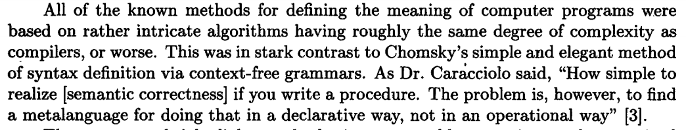
Benefits of Parse Trees
Assigning Meaning to Parse Trees

Slide 11

Benefits of Parse Trees
Assigning Meaning to Parse Trees
Impose structure on tokens
Easy to specify
Easy to process
good algorithms
are known
More generally:
Trees are great data structures
for nesting relationships

Slide 12
Two Ways of Thinking About Trees
Working with Trees
As a type of graph
Compilers use insights from both views
As a type of nesting
Root is a node, children are successors
Root is a tree, children are inside
Work “root-down” vs “leaves-up”
Work “outside in” vs “inside out”
A
A
B
B
C
D
C
D
E
E

Slide 13
Two Ways of Thinking About Trees
Working with Trees
As a type of graph
Compilers use insights from both views
As a type of nesting
A
Root is a node, children are successors
Root is a tree, children are inside
B
Work “root-down” vs “leaves-up”
Work “outside in” vs “inside out”
SDT Actions
Backpropagate translations results
from leaves to the root
Compilers use insights from both views
C
D
A
E
A
Same but subtrees depicted as triangles
A
B
B
C
D
C
D
E
E

Slide 14
Trees as a Nesting
Working with Trees
( 1 + ( 2 ) )
A
B
C
D
A = ( B )
E
B = C + D
C = 1
D = ( E )
E = 2

Slide 15
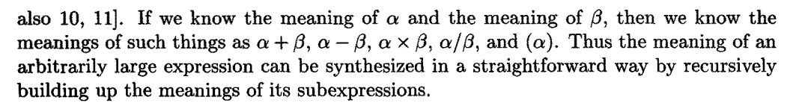
Trees as a Nesting
Working with Trees

Slide 16

Assigning Meaning to Subtrees
Processing Parse Trees
Goal:
Translation is
the value of
the expression
Assign a translation for
each node / subtree
E trans =
subtree 1
translation
subtree 3
translation
-
E trans =
subtree
translation
E
3
1
E
dash
T
4
T trans =
subtree
literal value
Grammar:
E ::= E dash T
| T
T ::= intlit
T
intlit
1
T trans =
subtree
literal value
4
intlit
4
Input Expression: 4 – 1

Slide 17
Assigning Meaning to Subtrees
Processing Parse Trees
Goal:
Translation is
the value of
the expression
E trans =
subtree 1
translation
subtree 3
translation
Assign a translation for
each node / subtree
-
1
E
T trans =
subtree
literal value
2
3
dash
T
E
1
intlit
2
E
dash
T
4
intlit
1
Grammar:
E ::= E dash T
| T
T ::= intlit
T
4
intlit
4
Input Expression: 4 – 1
– 2

Slide 18
Assigning Meaning to Subtrees
Processing Parse Trees
Goal:
Translation is
the value of
the expression
E trans =
subtree 1
translation
subtree 3
translation
Assign a translation for
each node / subtree
-
E trans =
subtree 1
translation
subtree 3
translation
1
-
E
T trans =
subtree
literal value
2
3
dash
T
E trans =
subtree
translation
E
1
intlit
2
E
dash
T
4
T trans =
subtree
literal value
Grammar:
E ::= E dash T
| T
T ::= intlit
T
intlit
1
T trans =
subtree
literal value
4
intlit
4
Input Expression: 4 – 1
– 2

Slide 19
In Summary
Processing Parse Trees
Translation depends on the goal
Goal:
Translation is the value of the expression
Goal:
Translation is the number of operands

Slide 20
Assigning Meaning to Subtrees
Processing Parse Trees
Goal:
Translation is
the number of
operators
E trans =
subtree 1
translation
subtree 3
translation
+
+
1
E trans =
subtree 1
translation
subtree 3
translation
2
+
+
1
E
T trans = 0
0
1
dash
T
E trans =
subtree
translation
E
0
intlit
2
E
dash
T
0
intlit
1
T trans = 0
Grammar:
E ::= E dash T
| T
T ::= intlit
T
T trans = 0
0
intlit
4
Input Expression: 4 – 1 – 2

Slide 21
Tree Translation Intuition: Summary
Processing Parse Trees
Translation depends on the goal
Translation is selected based on the production
Conceptually, a post-pass over the complete parse tree
E trans =
subtree 1
translation
subtree 3
translation
-
E trans =
subtree
translation
E
P1
P2
E
dash
T
Grammar:
T
intlit
1
P1
E ::= E dash T
P2
| T
intlit
4
P3
T ::= intlit

Slide 22
Lecture Outline
Preview Lecture 5 – Syntax-Directed Translation
Live Assignments
P1
H2
Recall Syntactic Ambiguity
Assigning Meaning to (Parse) Trees
Tree translation intuition
Introduce Syntax-Directed Definition
Tools for SDD
Bison
Syntax-Directed
Definition

Slide 23
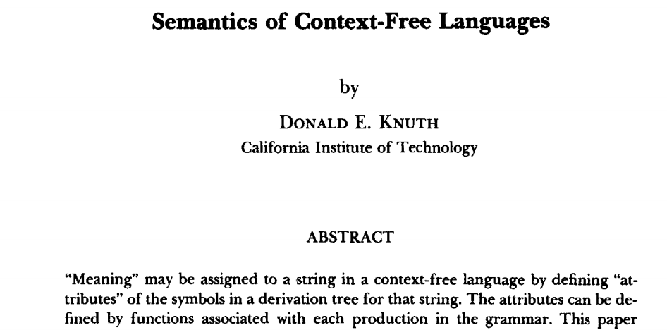
Syntax-Directed Definitions
Processing Parse Trees

Slide 24




Syntax-Directed Definitions
Processing Parse Trees
Attach translation rules per-production
X ::= $α1…αn$
{ LHS.trans = <translation of X that can use translations of $α1…αn$> }
| $β1…βn$
{ LHS.trans = <translation of X that can use translations of $β1…βn$> }
Y ::= $γ1…γn$
{ LHS.trans = <translation of Y that can use translations of $γ1…γn$> }
Goal:
Translation is
the value of
the expression
Grammar:
Arithmetic Rules:
P1
{ LHS.trans = E.trans – T.trans }
E ::= E dash T
P2
{ LHS.trans = T.trans }
| T
P3
T ::= intlit
{ LHS.trans = intlit.value }

Slide 25
SDD: Example
Processing Parse Trees
P1
rule
P1
rule
E trans =
subtree 1
translation
subtree 3
translation
E trans =
subtree 1
translation
subtree 3
translation
1
-
-
E
2
P3
rule
3
dash
T
T trans =
subtree
literal value
E
P2
rule
1
rule
P3
intlit
2
E trans =
subtree
translation
E
dash
T
T trans =
subtree
literal value
4
T
intlit
1
P3
rule
4
T trans =
subtree
literal value
intlit
4
Grammar:
Arithmetic Rules:
P1
{ LHS.trans = E.trans – T.trans }
E ::= E dash T
P2
{ LHS.trans = T.trans }
| T
P3
T ::= intlit
{ LHS.trans = intlit.value }

Slide 26
Lecture Outline
Syntax-Directed Definition
Live Assignments
P1
H2
Working with Parse Trees
Benefits of Parse Trees / Trees in general
Tree translation intuition
Syntax-Directed Definition
  Finer points
Tools for SDD
Bison
Syntax-Directed
Definition

Slide 27

SDD: Parse Tree Processing Multitool
Processing Parse Trees
SDD is a flexible tool for assigning meaning to parse trees
Useful beyond compilers
We won’t even use the full power of the technique

Slide 28
SDD: A Different Translation Scheme
Processing Parse Trees
SDD can do more than evaluate expressions
Goal:
Translate arithmetic expression to its number of operators
Grammar:
Operator Count Rules:
P1
{ LHS.trans = E.trans + T.trans + 1}
E ::= E dash T
P2
{ LHS.trans = T.trans }
| T
P3
T ::= intlit
{ LHS.trans = 0 }
P4
T ::= T mult intlit
{ LHS.trans = T.trans + 1 }

Slide 29
SDD: A Different Translation Scheme
Processing Parse Trees
2
E
P1
rule
1
E
0
dash
T
P4
rule
P2
rule
0
0
T
T
rule
mult
intlit
2
rule
P3
P3
intlit
1
intlit
1
Grammar:
Operator Count Rules:
P1
{ LHS.trans = E.trans + T.trans + 1}
E ::= E dash T
P2
{ LHS.trans = T.trans }
| T
P3
T ::= intlit
{ LHS.trans = 0 }
P4
T ::= T mult intlit
{ LHS.trans = T.trans + 1 }

Slide 30
SDD: Yet Another Translation
Processing Parse Trees
Myth: SDD translations are always int values
Goal:
Translate arithmetic expression to a list of its int literals
Grammar:
List of integers Rules:
P1
{ LHS.trans = E.trans.extend(T.trans) }
E ::= E dash T
P2
{ LHS.trans = T.trans }
| T
P3
T ::= intlit
{ LHS.trans = [intlit.value] }
P4
T ::= T mult intlit
{ LHS.trans = T.trans.extend([intlit.value]) }

Slide 31
SDD: Yet Another Translation
Processing Parse Trees
[1,2,3]
E
P1
[2,3]
E
[1]
dash
T
P4
P2
[2]
T
T
[1]
mult
intlit
3
P3
P3
intlit
2
intlit
1
Grammar:
P1
{ LHS.trans = E.trans.extend(T.trans) }
E ::= E dash T
P2
{ LHS.trans = T.trans }
| T
P3
T ::= intlit
{ LHS.trans = [intlit.value] }
P4
T ::= T mult intlit
{ LHS.trans = T.trans.extend([intlit.value]) }

Slide 32
SDD: Binary Numbers
Processing Parse Trees
Goal:
Translation is the value of the input
CFG Rules
  P1: B ::= 0 LHS.trans = ???
  P2: | 1 LHS.trans = ???
  P3: | B 0 LHS.trans = ???
  P4: | B 1 LHS.trans = ???
Example:
Input string 10110
should be 22

Slide 33
SDD: Binary Numbers
Processing Parse Trees
Goal:
Translation is the value of the input
CFG Rules
  P1: B ::= 0 LHS.trans = 0
  P2: | 1 LHS.trans = 1
  P3: | B 0 LHS.trans = B₁.trans * 2
  P4: | B 1 LHS.trans = B₁.trans * 2 + 1
22
B
Example:
Input string 10110
should be 22
11
B
0
5
B
1
2
B
1
1
B
0
1

Slide 34
SDD: Int Declaration List
Processing Parse Trees
CFG Rules
DList ::= ε LHS.trans = “”
  | DList Decl LHS.trans = Decl.trans + “ “ + DList₂.trans
Decl ::= Type id ; if (Type.trans) {LHS.trans = id.value} else {Decl.trans = “”}
Type ::= int LHS.trans = true
| bool LHS.trans = false
“xx ”
DList
Input string
int xx;
bool yy;
“xx ”
DList
“”
Decl
Translation is a String of int ids
only
false
Type
id
“”
DList
“xx”
Decl
true
Type
id
bool
ε
int

Slide 35
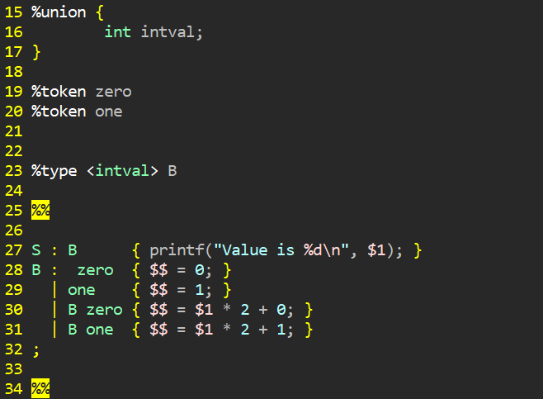
BISON: A tool for SDD
Assigning Meaning to Parse Trees

Slide 36
Next Time
Lecture Preview
Discuss a use of SDD of particular use to Compilers:
Translating the parse tree into an Abstract Syntax Tree

