Slide 1
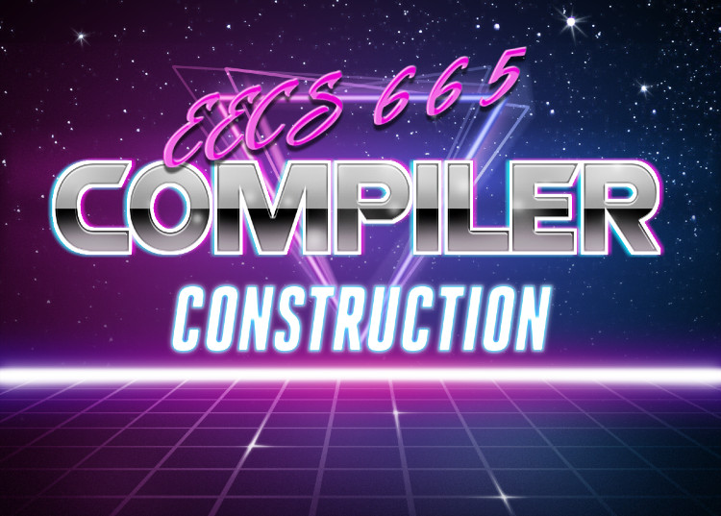
Abstract Syntax Trees
University of Kansas | Drew Davidson

Slide 2
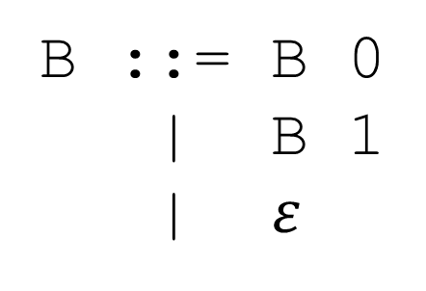
Check-In
Warm-up
Assign SDD rules to each of the following rules according to the following goal:
Goal: Each B translates to whether the
subtree has an odd number of “1”s
B ::= B 0
| B 1
| $ε$

Slide 3
Announcements
Lecture 6 – Abstract Syntax Trees
Quiz 1 next Friday during class period
Covers material up to and including today’s lecture
Review Session
Wednesday at 6:00 – 8:00

Slide 4

Last Time
Review: Syntax-Directed Translation
Live Assignments
P1
H2
Working with Parse Trees
Perspectives on trees
  Data structure / recursive definition
Syntax-Directed Definitions
  Specifies meaning of parse trees
    Digit sequence as integer
    Expression as its evaluation
    Expression as its operator count
Syntax-Directed
Definition

Slide 5
Today’s Outline
Abstract Syntax Trees
Live Assignments
P1
H2
Abstract Syntax Trees
Context for ASTs
ASTs for Programs
ASTs in Code
Syntax-Directed
Definition

Slide 6

Compiler Construction
Progress Pics
Live Assignments
P1
H2
Source code
We have most of the concepts of syntactic analysis
Lexical
analysis
Token stream
We are here
Syntactic
analysis
(Parse tree)
Syntactic Analysis
Output: AST
Specification:
  Syntax: CFG
  Semantics: SDD
Semantic analysis
Abstract syntax
tree
Intermediate code generation
Intermediate code optimization
Code generation
just need to apply the concepts to a programming language
Final code optimization
Target code

Slide 7
The Parse Tree vs AST
Abstract Syntax Trees
Live Assignments
P1
H2
Parse tree
Recognizes valid syntax
Nodes are rules that constrain structure
AST
Transcends concrete syntax
Represents program semantics
Nodes are language concepts
AST
subtraction
4
multiplication
7
3
Parse tree
Expr
Expr
minus
Term
Term
Term
times
Factor
Factor
Factor
intlit:3
intlit: 4
intlit: 7

Slide 8

AST: Implicit in the Parse Tree
Abstract Syntax Trees
Parse tree implies an AST
Syntactic analysis “extracts” the AST from the parse tree
Conceptually, a post-processing pass over the parse tree
A tree within a tree

Slide 9
AST: Implicit in the Parse Tree
Abstract Syntax Trees
Parse Tree for (5+2)*8
Nonterminals map to language concepts
“What’s the intuition?”
Expr
mult
Term
syntactic
details
omitted
Term
*
Factor
int
(8)
Factor
intlit
8
operators
at branches
(not leaves)
AST for (5 + 2) * 8
(
add
Expr
)
Expr
+
Term
mult
add
Term
Factor
int
(8)
collapsed
production
chains
int
(2)
int
(5)
Factor
intlit
2
int
(5)
int
(2)
intlit
5

Slide 10

From Parse Tree to AST
Abstract Syntax Trees
Live Assignments
P1
H2
SDD knocks the AST out of the parse tree
AST
SDD
Parse
Tree

Slide 11
Defining AST Structure
Abstract Syntax Trees
CFG Production
AST Building Rule (Pseudocode)
Input String: a + b
P1
E ::= T
LHS.trans = T.trans
E
add
E ::= E plus T
LHS.trans = AddNode where
AddNode.arm1 = E.trans
AddNode.arm2 = T.trans
P2
P2
E
plus
T
P1
P3
T
F
T ::= F
LHS.trans = F.trans
P3
P6
ID
b
P3
F
id
b
LHS.trans = MultNode where
MultNode.arm1 = T.trans
MultNode.arm2 = F.trans
P6
ID
a
P4
T ::= T times F
id
a
F ::= lpar E rpar
P5
LHS.trans = E.trans
P6
F ::= id
LHS.trans = IDNode where
IDNode.content = id.value

Slide 12
Defining AST Structure
Abstract Syntax Trees
CFG Production
AST Building Rule (Pseudocode)
Input String: a + b
P1
E ::= T
LHS.trans = T.trans
add
P2
E ::= E plus T
LHS.trans = AddNode where
AddNode.arm1 = E.trans
AddNode.arm2 = T.trans
T ::= F
LHS.trans = F.trans
ID
b
P3
LHS.trans = MultNode where
MultNode.arm1 = T.trans
MultNode.arm2 = F.trans
ID
a
P4
T ::= T times F
F ::= lpar E rpar
P5
LHS.trans = E.trans
P6
F ::= id
LHS.trans = IDNode where
IDNode.content = id.value

Slide 13
Today’s Outline
Abstract Syntax Trees
Live Assignments
P1
H2
Abstract Syntax Trees
Context for ASTs
ASTs for Programs
ASTs in Code
Syntax-Directed
Definition

Slide 14


Capturing Program Constructs
Abstract Syntax Trees – ASTs for Programs
ASTs can (and must) capture all program constructs
Simply need to attach the right SDD rule to each production
May need to tweak the grammar a bit
  (we already saw this with syntactic ambiguity)

Slide 15
Capturing Program Constructs
Abstract Syntax Trees – ASTs for Programs
L ::= D
LHS.trans = [ D.trans ]
Input String:
int a; bool b; int c;
P1
P2
| L D
LHS.trans = [].addAll(L.trans).add(D.trans)
P3
D ::= T I ;
LHS.trans = VarDeclNode where
Node.type = T.trans
Node.name = I.trans
L
[ *, *, *]
P2
P4
I ::= id
LHS.trans = IdNode where
Node.content = id.value
P5
T ::= int
| bool
LHS.trans = IntTypeNode
L
[ *, *]
VarDecl
D
P6
LHS.trans = BoolTypeNode
P2
P3
[ * ]
Int
Type
T
I
ID:
c
;
L
D
VarDecl
P5
P4
P1
P3
VarDecl
T
Bool
Type
I
ID:
b
;
int
id: c
D
P3
P6
P4
T
Int
Type
I
ID:
a
;
bool
id: b
P5
P4
int
id: a

Slide 16
Capturing Program Constructs
Abstract Syntax Trees – ASTs for Programs
L ::= D
LHS.trans = [ D.trans ]
Input String:
int a; bool b; int c;
P1
P2
| L D
LHS.trans = [].addAll(L.trans).add(D.trans)
P3
D ::= T I ;
LHS.trans = VarDeclNode where
Node.type = T.trans
Node.name = I.trans
[ *, *, *]
P4
I ::= id
LHS.trans = IdNode where
Node.content = id.value
P5
T ::= int
| bool
LHS.trans = IntTypeNode
VarDecl
P6
LHS.trans = BoolTypeNode
Int
Type
ID:
c
VarDecl
VarDecl
Bool
Type
ID:
b
Int
Type
ID:
a

Slide 17
Capturing Program Constructs
Abstract Syntax Trees – ASTs for Programs
L ::= D
LHS.trans = [ D.trans ]
Input String:
int a; bool b; int c;
P1
P2
| L D
LHS.trans = [].addAll(L.trans).add(D.trans)
P3
D ::= T I ;
LHS.trans = VarDeclNode where
Node.type = T.trans
Node.name = I.trans
[ *, *, *]
P4
I ::= id
LHS.trans = IdNode where
Node.content = id.value
P5
T ::= int
| bool
LHS.trans = IntTypeNode
VarDecl
VarDecl
VarDecl
P6
LHS.trans = BoolTypeNode
Int
Type
ID:
a
Bool
Type
Int
Type
ID:
c
ID:
b
AST: much more intuitive program representation

Slide 18
Today’s Outline
Abstract Syntax Trees
Live Assignments
P1
H2
Abstract Syntax Trees
Context for ASTs
ASTs for Programs
ASTs in Code
Syntax-Directed
Definition

Slide 19

What do ASTs Look like in Code?
Abstract Syntax Trees – ASTs in Code
Let’s contemplate source code to implement ASTs

Slide 20
Implementing AST Nodes
Abstract Syntax Trees – ASTs in Code
We’ve given AST nodes pseudocode properties
We’ll lean into that with C++ classes and members
class DeclNode{
TypeNode& type;
IDNode& name;
};
CFG Production Rule
Decl ::= Type ID ; LHS.trans = DeclNode where
.type = Type.trans
.name = ID.trans
class IDNode{
char * content;
};
ID ::= id LHS.trans = IDNode where
.content = id.value

Slide 21
Recall OOP: is-a vs has-a
Abstract Syntax Trees – ASTs in Code
class Lunch {
public:
void eat(){ … }
};
int main(){
HotDog * h = new HotDog();
Mustard * m = new Yellow();
h->myM = m;
h->eat();
}
class HotDog : public Sandwich{
public:
Ketchup * myK;
Mustard * myM;
};
h->myM = k; (error)
A hot dog is a sandwich
A hot dog is a lunch
Components (has-a relation)
Inheritance (is-a relation)
Lunch
Condiment
Hot Dog
Mustard is a
condiment
field
myM
field
myK
Soup
Sandwich
Ketchup
Mustard
Mayo
Ketchup
Mustard
A hot dog has a mustard topping
HotDog
StoneGround
Yellow

Slide 22
ASTs In Code: Connecting Subtrees
Abstract Syntax Trees – ASTs in Code
Naïve
AST for 1+2
AST Implementation
PlusNode
Oops! Disallows
Variables in
expressions!
arm1
arm2
class PlusNode
{ IntNode& arm1;
IntNode& arm2;
};
IntNode
value: 1
IntNode
value: 2
class IntNode
{ int value; };
AST for var+2
PlusNode
class IDNode
{ std::string content; };
arm1
arm2
IDNode
name: var
IntNode
value: 2

Slide 23
ASTs: Connecting Subtrees
Abstract Syntax Trees – ASTs in Code
Naïve
AST Implementation
class ASTNode{ … };
Class hierarchy for AST Nodes
class PlusNode
{ IntNode& left;
IntNode& right;
};
: public ASTNode
ASTNode
ASTNode
IntNode
IDNode
DeclNode
class IntNode
{ int value; };
: public ASTNode
…
class IDNode
{ std::string content; };
: public ASTNode
class DeclNode : public ASTNode
{ … }

Slide 24
ASTs: Connecting Subtrees
Abstract Syntax Trees – ASTs in Code
Less Naïve
Naïve
AST Implementation
class ASTNode{ };
Wrongly allows
all node types!
Too generic!
int foo; + 7
class PlusNode
{ ASTNode& left;
ASTNode& right;
};
: public ASTNode
PlusNode
left
right
class IntNode
{ int value; };
: public ASTNode
DeclNode
IntNode
7
class IDNode
{ std::string content; };
: public ASTNode
type
name
IntTypeNode
IdNode
foo
class DeclNode : public ASTNode
{ … }

Slide 25
ASTs: Connecting Subtrees
Abstract Syntax Trees – ASTs in Code
Ok
Less Naïve
Naïve
Solution:
Proper line of succession
AST Implementation
class ASTNode{ };
Class hierarchy for AST Nodes
class ExprNode : public ASTNode {};
class PlusNode
{ ASTNode& left;
ASTNode& right;
};
: public ASTNode
ASTNode
ExprNode
ExprNode
IntNode
IDNode
class IntNode
{ int value; };
: public ASTNode
…
ExprNode
DeclNode
class IDNode
{ std::string content; };
: public ASTNode
…
ExprNode
class DeclNode : public ASTNode
{ … }

Slide 26
Crafting the AST Hierarchy
Abstract Syntax Trees – ASTs in Code
Which classes should inherit which other classes?
No one “right way” to do it

Slide 27
Summary
Abstract Syntax Trees
The Abstract Syntax Tree
A lightweight abstraction of the program syntax
A data structure in the compiler’s host language
  Lexical Tokens: Flex Regular Expression Rules
  Parse Tree: Bison Context-Free Grammar Rules
  AST: Back to C++ objects and classes

