Slide 1
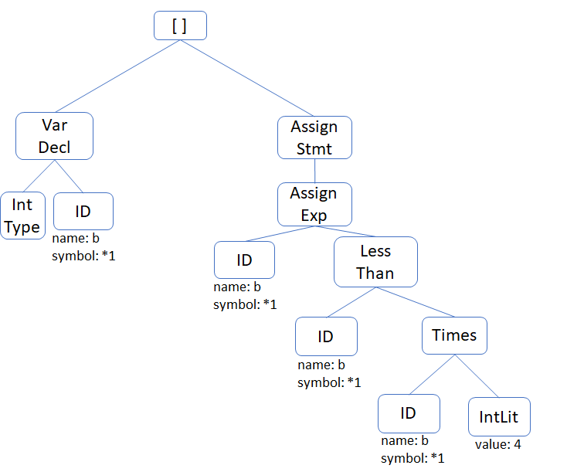
Check-In
Review – Type Checking
Assume a program snippet has generated the following AST. Annotate each node with the type it corresponds to (or error if it is an error type). If a type analysis would issue a report, indicate that as well.

Slide 2
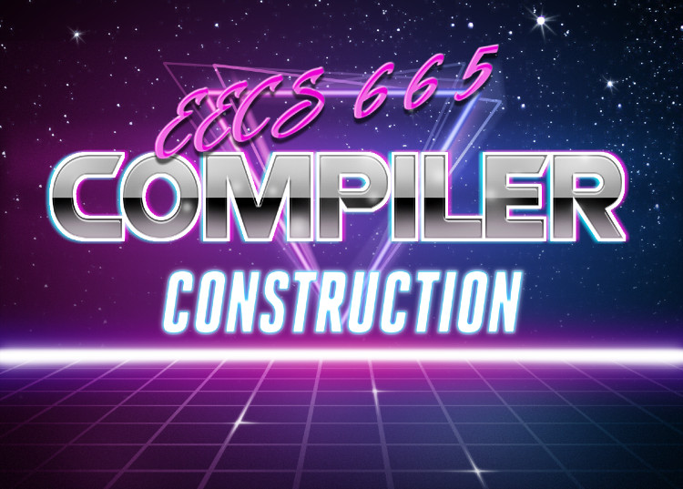
Error Reporting
University of Kansas | Drew Davidson

Slide 3

Last Time
Lecture Review – Type Analysis
You Should Know
The meaning of different aspects of type systems
The simple AST-based type analysis
How to propagate type errors
Types
What they are
Why we have them
Type Rules
Examples
Connecting operations to their types
Enrich our static analysis pass
Semantics

Slide 4
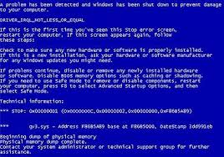
Handling Errors
Type Analysis – Implementing Type Checking
We’d like all distinct errors at the same time
  Don’t give up at the first error
  Don’t report the same error multiple times
When you get error as an operand
  Don’t (re)report an error
  Again, pass error up the tree

Slide 5
Type Error Example
Type Analysis – Implementing Type Checking
int a;
bool b;
a = true + 1 + 2 + b;
b = 2;
StmtList
AssignStmt
AssignStmt
error
REPORT
error
AssignExp
AssignExp
int
error
bool
int
IdNode
Plus
IdNode
IntLit
symbol
bool
error
type: int
name: a
Plus
IdNode
symbol
symbol
error
int
REPORT
Plus
IntLit
2
type: bool
name: b
bool
int
BoolLit
true
IntLit
1

Slide 6
Today’s Outline
Lecture Overview – Error Reporting
Error Checking
What counts as a bad program?
How do we detect bad programs?
Limits of Analysis
The halting problem
Semantics

Slide 7
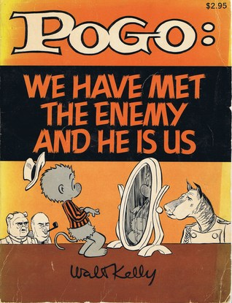
Error Checking
Semantic Analysis
Goal: save programmers from themselves
It’s not enough to compile the programmer’s code
Need to figure out what programmer meant to code

Slide 8
Quick Audience Poll
Semantics – Error Checking
Does this C program compile?
Should this C code compile?
int a = 0;
int main(){
if (false){
b = 6;
}
return a;
}

Slide 9

A Compiler’s Error-Checking Obligation
Semantics – Error Checking
Understandability / Consistency

Slide 10

Compiler As Mind Reader
Semantic Analysis – Broad View
A machine that infers your intent

Slide 11
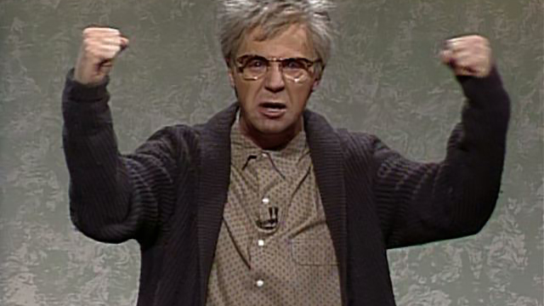
Compiler as Complainer
Semantic Analysis – Broad View
A grumpy old man that yells at you for breaking the rules

Slide 12
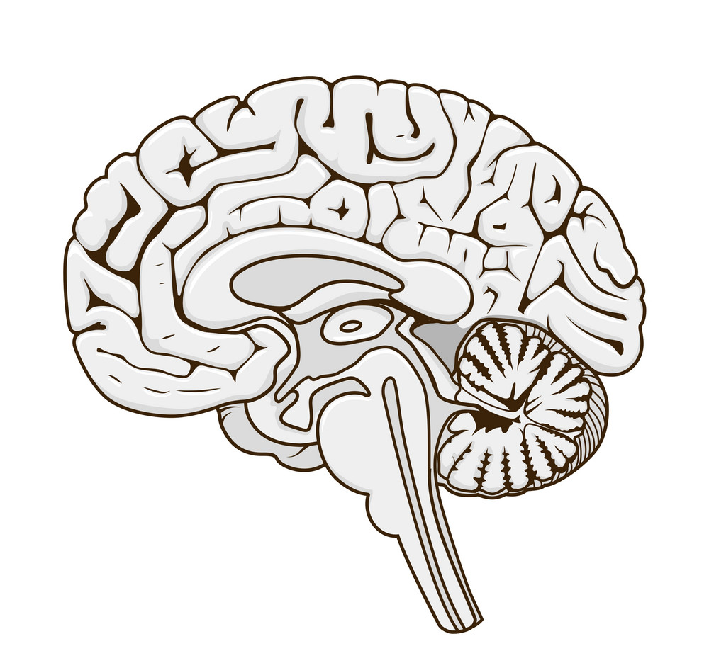

The Compiler Before the Compiler
Semantic Analysis – Broad View

Slide 13
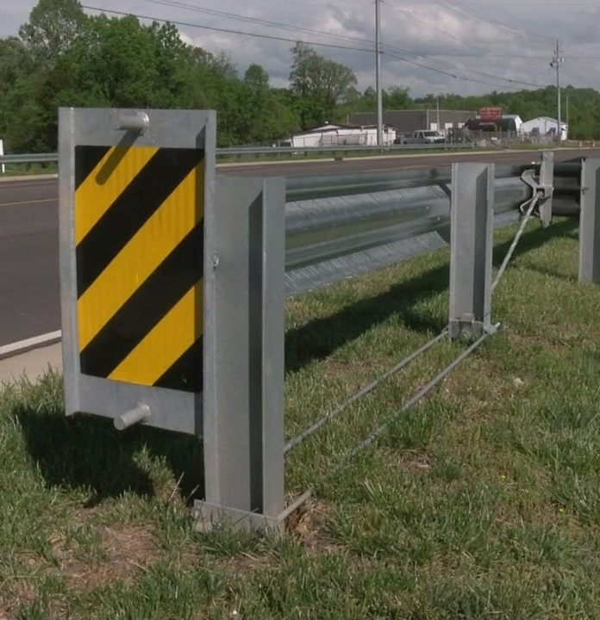
Bug Hunting
Semantic Analysis – Broad View
How do we prevent nonsense code from executing?
We’ll consider two ways of analysis:
  Static
  Dynamic
Putting guardrails on computation

Slide 14
Compiler Perspective
Semantic Analysis – Broad View
Static
Code analysis without execution
Dynamic
Code analysis through execution
Checks done at compile time
Analysis part of the compiler itself
Checks done at run time
Analysis embedded into the program

Slide 15
Compiler Focus: Static Analysis
Semantic Analysis – Broad View
Doesn’t slow the program down
  Ok to take longer
  Ok to apply more heavyweight analysis
Has a “holistic” view of the program
  Has access to source code
  Knowledge of non-executed program paths

Slide 16
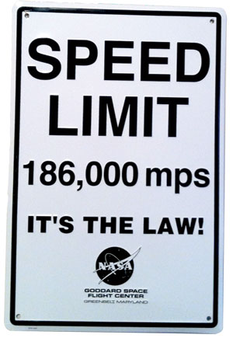
Limits of Error Checking
Static Analysis
We’d LOVE to ensure bug-free programs
  Observe and report bugs before they are encountered
Usually we can’t do this
  Limits of static analysis

Slide 17


Limits of Static Analysis
Static Analysis
Theoretical argument
Practical argument

Slide 18
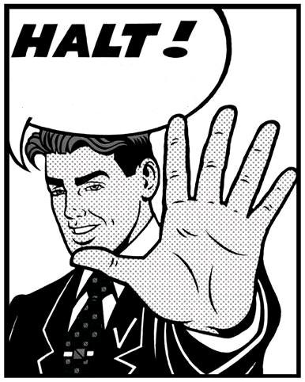
The Halting Problem
Static Analysis
Does a computation ever terminate?
Given a description of a Turing machine and its initial input, determine whether the program, when executed on this input, ever halts (completes). The alternative is that it runs forever without halting

Slide 19
Sketching the Halting Problem
Static Analysis
Effective procedure
a procedure that is always yields a correct result on any input
Any program
White Magic
Effective method for the halting problem would say:
Return “true” if the program halts on the given input
Return “false” if the program never halts on the given input
True:
Program halts
False:
Program spins

Slide 20
No Effective Method for Halting
Static Analysis
Black Magic
assume white_magic(Function p)
returns true if p halts, false if p does not
Black Magic
White Magic
void black_magic(){
if white_magic(black_magic){
while true { }
}
}
Blackmagic halts
Blackmagic spins
spin
return
White Magic
True:
Program halts
False:
Program spins

Slide 21
Implications of the Halting Problem
Static Analysis
What does this have to do with, say, a null pointer analysis?
No halting solution means no reachability solution
int * a = nullptr;
int main(){
if (a != nullptr){
*a = 1;
}
return a;
}

Slide 22


Rice’s Theorem
Static Analysis
“All non-trivial semantic properties of programs are undecidable”

Slide 23
Rice’s Theorem – Basic Idea
Static Analysis - Limits of Error Checking
What does this have to do with, say, a null pointer analysis?
No halting means no reachability
int main(){
if (black_magic()){
int * p = 0;
*p = 42;
} else {
return 0;
}
}

Slide 24
Rice’s Theorem - Implications
Detour – Limits of Error Checking
We’d like to perfectly capture all bugs
  We can’t be right all of the time
  We can choose HOW we are wrong

Slide 25
Limits of Static Analysis
Static Analysis
Theoretical argument
Practical argument
What if we only consider the universe of programs not written by *$%!-heads?
(bleep)

Slide 26

Practical Argument
Static Analysis
It’s really hard!

Slide 27

Let’s do some Sciency-Sounding Stuff
Evaluation

Slide 28
Evaluating a Bug Detector
Evaluation
True
False
Has report
Has report
Has bug
No bug
Positive
report
bug
Correct
Type I
Error
No report
No report
No bug
Has bug
Negative
Type II
Error
No bug
report
Correct
Analysis is correct
Analysis is wrong

Slide 29
Guarantees Under Imperfect Detection
Limits of Error Checking
Consistency / Reliability super important for users
We’d like to limit the kinds of errors we report
We can choose which type of bug report error to avoid
Soundness: No false positives
Completeness: No false negatives

Slide 30
Visual Analogy
Limits of Error Checking
Reported
bugs
Imagine the universe of all programs is contained in a circle
You can draw a circle around the programs you report as buggy
The actual buggy programs occupy a jagged region
All Programs
Buggy programs

Slide 31
Soundness and Completeness
Limits of Error Checking
Reported
bugs
Reported
bugs
All Programs
All Programs
Buggy programs
False
Positive
Buggy programs
False
Negative
Sound bug detection
Complete bug detection
All correct programs pass through
(No false positive problem)
All buggy programs get flagged
(No false negative problem)
Some buggy programs pass through
(has false negative problem)
Some correct programs get flagged
(has false positive problem)

Slide 32
Partial Correctness
Limits of Error Checking
Make best-effort procedures that are neither sound nor complete
We can analyze the result of a statement under certain assumptions
  Assume that the statement is executed
  Assume that the statement actually completes

